Slide 1
International Roma Accelerator
International Romani Union- IRU
Project proposal

Slide 2
International Romani Union- IRU & 55 COUNTRIES
ACCELERATOR
&
AIRBCM-NGO North Macedonia
WEBSITE/PORTAL
INVESTMENT FUND
THE BORD & MONITORING
WORLD BANK, EU BANKS, EU COMMISIONS, FONDATIONS, DONATORS, IBRD etc.
NGO
COMPANIES

Slide 3
Project goals
Establishment of an investment fund
Encouraging minority entrepreneurship by moving the start-up scene
Education (creating and managing a start up business)
Financial support for the development of innovative start-up businesses
Advanced spin-off and P&P projects
Economic progress
Educating small business owners to increase resilience in order to develop their own strategy

Slide 4
What is our mission?
Development of Roma network business (business incubators)
Development and implementation of practices that would result in start up businesses (micro and macro businesses)
Connecting applicants with professional consultants. (preparation of a business plan)
Developing old and new businesses

Slide 5
Investments
Investing in business entities with innovative products and / or services.
Investing in a Start Up Business
Investing in entrepreneurial education
Investing in micro and small companies

Slide 6
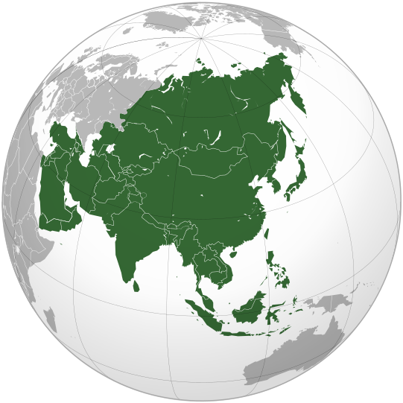
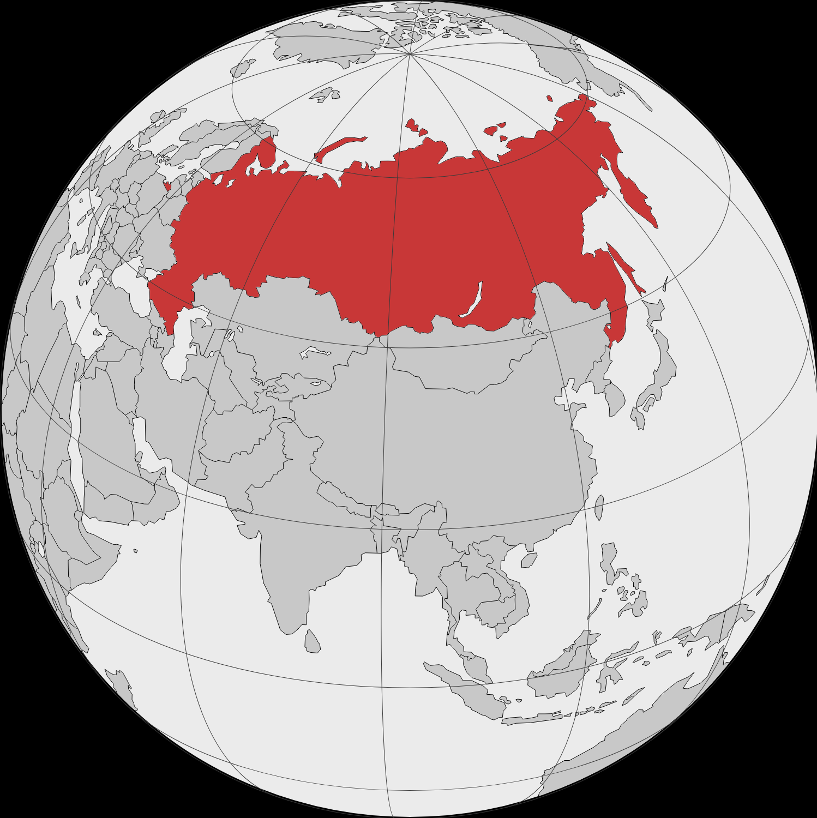
Geographical focus
Europe
Western Balkans
Asia
America
Russia

Slide 7
Eligibility and criteria
Eligibility
Criteria
Team support for each individual to fulfill their dream and establish a business or non-profit organization
Start up businesses to be supported in their innovative solutions
Support for ongoing problems and rapid growth and development
Northern Macedonia and the Western Balkans will be the first example of such a market.

Slide 8
How the Accelerator works?
Support to on-going business
Start-ups
Assessment of the business (needs and capacities)
Risk assessment of new investments and reinvestments
Joint ventures
Know-how and in-kind (up to 20%)
Membership fee/share from the Income generated by the new business development
Business plan development
Know-how and in-kind (up to 20%)
Business incubation up to 2 years (based on membership fee/share from the profit)

Slide 9
Type of support
Know-how
In-kind
Direct support in improving the products/services (eg: after branding/labeling, buying an equipment for this) up to 20% (to be set limit according to SME criteria)
Direct support in improving the products/services (eg: after branding/labeling, buying an equipment for this) up to 20% (to be set limit according to SME criteria)

Slide 10
What should applicants agree to?
Attend all meetings during the program!
Make all interviews a priority!
Commitment!
Active involvement in the program!
Readiness!
Focus and concentration!
Timely completion of assessment questionnaires!

Slide 11
The selection of candidates will be based on the following criteria:

Slide 12
Primary
Business idea / concept
Development phase
Team composition and commitment
Ability to develop a business

Slide 13
Secondary
Market / profit
Degree of innovation
Publicity of established strategies
Maintaining a competitive advantage
Team capacity
Willingness to co-finance the project through own participation
Reality of financial / budget projections
Maintenance of the entire business model

Slide 14
Benefits for applicants!

Slide 15
Help with the business model
Defining priorities
Setting a milestone and starting teamwork
Partnership and cooperation with other companies
Money management skills
Marketing

Slide 16
What opportunities does the accelerator offer?
Acquisition of practical tools for identifying challenges
Ability to assess risks and create a business model
Opportunity to network and discover new sources of collaboration
Collaboration with other creative applicants
Better understanding of potential markets and their development
Gaining confidence in business decision making
Access to industry experts
Workshop trainers
Custom counseling sessions

Slide 17
What do we get for the support we provide?

Slide 18
Motive, obligation, investment ...
The key motivation for investing is to make a profit when the value of the business grows to a satisfactory level.
It has the option to offer collateral in the form of collateral, mortgages, etc.
By investing in each of the start-up businesses, the legal entity International Roma accelerator acquires an appropriate share in the ownership structure of the company.

Slide 19
What percentage of shares does the accelerator acquire? Is he becoming the dominant owner of the company?
The goal is not to be the dominant owner.
The amount of the share will depend on the amount of funds that will be invested, the evaluation of the start up business, etc.
The percentage of the share will depend, above all, on the assessment of their attractiveness and the belief that there will be fast, global and sustainable growth.

Slide 20
Monitoring and control
The monitoring and control by the accelerator will be regulated in a special agreement that will be signed before the start of the project activities.
Entrepreneurs / management teams will manage the operational ie daily operations.
Investors will participate in the process of making important strategic decisions for business growth and development.

Slide 21
Sequence of activities in the accelerator program
Application, pre-accelerator phase, accelerator program

Slide 22
Application
Fill in and send a short application form.
GOAL:
Initial evaluation of the business idea.

Slide 23
Pre-accelerator phase
This phase is for startups that will pass the first stage of evaluation.
Objective: To train them for making a more advanced version of the business plan and continuous evaluation by applying various techniques
Long application form - a more advanced version of the business plan.
OBJECTIVE: SELECTION OF 5-10 STARTUPTIES BETWEEN THE FINAL INVESTMENT CHOICE WILL BE MADE.

Slide 24
ACCELERATION PROGRAM
Implementation of the Accelerator program entitled: BIRD, and making a final decision to invest in the most attractive startups.

